Slide 1
Manchester’s
Banded Council Tax Support scheme for Universal Credit claimants
Amy Brickland and Mark Holroyd
Manchester City Council

Slide 2
What we’ll cover
Background and why we did it
The proposals
Banded scheme
Consultation and EIA
Other changes
System functionality
Costs / outcomes
Potential issues
Time for questions

Slide 3
Caseload
In April 2017 Council Tax Support (CTS) caseload was 58,874
18 months later this had dropped to 54,208 ( 8% drop)
36,733 are working age claimants ( 63%)
Notes:
Mark

Slide 4
CTS scheme since 2017/18
Maximum CTS 82.5%
No 2AR
Aligned to HB changes
    No family premium
    Two child limit
    Period outside GB reduced to 4 weeks
Notes:
Mark

Slide 5
Why we decided to review
Universal Credit (UC) Full Service roll out completed in July 2018
UC managed migration possible in late 2019/20 – latest intention is 10,000 pilot cases starting in July 2019 in Harrogate
Ongoing impact on CTS administration, Council Tax billing & recovery because of monthly UC assessments
Concern around CTS take up
Notes:
Mark

Slide 6
Expectations of the new scheme
Cost neutral
Maximises take-up and entitlement
Reduces administration caused by dealing with changes
Simple to understand and manage the scheme
No negative effect on Council Tax recovery
Notes:
Mark

Slide 7
New scheme proposals
Introduction of a “banded” CTS scheme
Amend what we consider a “claim” for CTS
Adjust our start date for people moving on and off UC and/or CTS
Stop sending letters where there is no change to the award
Notes:
Mark

Slide 8
Banded scheme modelling
We modelled 4 schemes using the same bands of income but adjusting the % amount of CTS up to 82.5% maximum support
£0 over applicable amount
£0.01 - £25 over
£25.01 - £50 over
£50.01 - £75 over
£75.01 - £80 over
£80.01+
Notes:
Mark

Slide 9
Models 1, 2, 3 and 4
10%, 35%, 60%, 75%, 82.5%
12%, 32%, 55%, 75%, 82.5%
12%, 32%, 50%, 75%, 82.5%
12%, 30%, 45%, 70%, 82.5%
All with similar losers and gainers but costs different
Notes:
Mark

Slide 10
Model 4 – our chosen option
12%, 30%, 45%, 70%, 82.5%
30 claimants lose £5 or more
85% no change
10% gain
5% lose (199 claimants)
Notes:
Mark

Slide 11
Banded scheme
Band of income | Amount of CTS-subject to NDDs
£0 over your applicable amount | = support for 82.5% of Council Tax
£0.01- £25 over | = support for 70% of Council Tax
£25.01- £50 over | = support for 45% of Council Tax
£50.01- £75 over | = support for 30% of Council Tax
£75.01- £80 over | = support for 12% of Council Tax
£80.01 + | = no CTS
Notes:
Mark

Slide 12
Impact on claimants
Total CTS caseload = 54,208
Elderly | 17,475
Working age non UC | 31,201
Working age UC | 5,532
 | Gain | Loss | No change | Total
Cases | 530 | 199 | 4,803 | 5,532
Average loss / gain | £2.21 | £1.03
Highest loss/gain | £5.14 | £6.76
Notes:
Mark

Slide 13
Discretionary Council Tax
For the 199 losers
One off DCTS payment
Paid the amount lost over and above £1 per week for a 12 month period from 1 April 2019
Notes:
Mark

Slide 14
What does our banded scheme mean?
We have 8,862 CTS claimants on UC
1,329 of these have excess income (15%)
The bands apply to those who have excess income
Those without excess income receive 82.5% CTS
Notes:
amy

Slide 15
What UC information do we use?
The claimant’s allowance, housing element, child element plus amounts for disability/caring are added together to create their Maximum UC award
UC then reduces their Maximum UC award if they have any income, e.g. wages or occupational pensions
How much is taken off the Maximum UC depends on earnings disregards and the relevant taper
The UC payment is whatever is left once these deductions have been taken off
Notes:
amy

Slide 16
How we calculate excess income
Our banded scheme compares the Maximum UC award with the actual income that the claimant received that month (their UC payment plus their wages and other income)
We then convert this to a weekly figure to decide which band they fall in to
Notes:
amy

Slide 17
Example
Single claimant (over 25) with housing costs
Maximum UC award is £774.21
Net earnings are £550
UC payment is £427.71
Total income is £550 + £427.71 = £977.71
Excess income is £977.71 - £774.21
= 203.50
Notes:
amy

Slide 18
Example
Excess income of £203.50 converted to a weekly figure is £46.96
This puts the claimant in our second band for those with excess income of £25.01 to £50.00
CTS award is 45%
Notes:
amy

Slide 19
Consultation
5 November to 16 December
Online and mailout
30,000 letters
  15,000 Council Tax payers
  6,000 UC claimants
  9,000 other CTS claimants (minus pensioners)
Notes:
Mark

Slide 20
Consultation
1051 responses
    242 online
    809 paper
    In favour of our proposals
Notes:
Mark

Slide 21
Consultation
Do you agree or disagree that we should move to a banded scheme from April 2019
Strongly agree | 23%
Agree | 32%
Neither agree nor disagree | 15%
Disagree | 6%
Strongly disagree | 6%
Don’t know | 16%
Not answered | 2%
Notes:
Mark

Slide 22
Consultation
Do you agree that we have worked out the bands correctly?
Yes | 68%
No | 21%
Not answered | 11%
Notes:
Mark

Slide 23
EIA
Only a small number of claimants lost out overall but still needed to do an EIA (199).
We gathered lots of data
    UC gainers & losers by band
    Gender, family composition & ethnicity
    Caring responsibilities and disability
    Ward
    Valuation band
Notes:
Mark

Slide 24
EIA
In every area where we collected data, the losers were broadly representative of the caseload as a whole (and in relation to disability potentially less impacted) and the losers were not disproportionately affected in any of the areas with protected characteristics
Also the numbers were so small as part of the overall caseload (199 out of 5,532 CTS UC claimants).
Notes:
Mark

Slide 25
New CTS Claims
We updated the scheme so that people no longer need to make a separate claim for CTS when they claim UC
If the claimant says they want to claim CTS when they apply for UC then we can treat the new claim UCDS record and the subsequent first payment record as a claim for CTS
Our scheme defines a claim for CTS as requiring both of these (so one record on its own does not count as a claim)
Notes:
Amy

Slide 26
Break in UC entitlement
If people have a break in UC entitlement they may not know they need to reclaim CTS when their UC restarts
We pay their CTS from the Monday after their UC restarted or 6 months before they reclaimed CTS, whichever is later

Slide 27
Gaps in CTS caused by UC changes
As UC fluctuates it can result in the claimant’s income being too high to qualify for CTS
The income can then drop again to a level that would qualify for CTS
We pay their CTS from the Monday after their UC was at level to qualify for CTS or 6 months before they reclaimed CTS, whichever is later
Notes:
Amy

Slide 28
Notification letter
We aim to stop sending Academy adjustment letters unless the change results in the claimant moving bands and adjusts their CTS award
Not in place yet
Intend to introduce this once we have been able to automate UCDS changes
Notes:
amy

Slide 29
System functionality
CAPITA
Banded scheme software – purchase cost plus annual licence
Parameters had to be configured – very flexible
Letters also required configuration
Non-dependant deduction issue
Notes:
amy

Slide 30
Costs of the CTS scheme
CTS 2018/19 cost | £37,658,537.29
CTS for 2019/20 at billing | £38,623,871.17
CTS for 2019/20 at 13/06/19 | £39,226,378.84
Increase of 2019/20 scheme so far | 4.2%
Council Tax increase for 2019/20 | 5.1%
Notes:
Amy

Slide 31
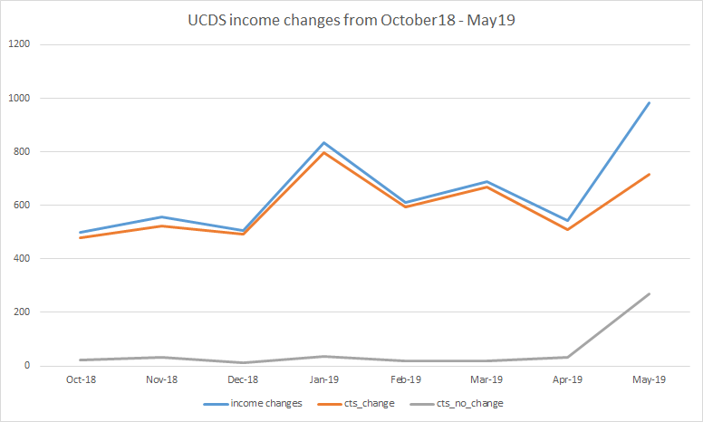
Outcomes
This chart shows the number of UCDS income changes and the result of the CTS claims

Slide 32
Potential issues
Cliff edges - increases in bills as people move between bands.
Claimants in higher banded properties are more likely to lose out under a banded scheme
Both of these can be mitigated using Discretionary Payments if we feel it is appropriate
Notes:
amy

Slide 33
Questions

