Slide 1
Council Tax Reduction Schemes Considerations for Local Authorities
Caroline Lee
Head of Revenues, Benefits and Business Support Oldham Council
June 2019

Slide 2
Content of this session
Background and context
Impact on Local Authority funding
Impact on people
Council Tax – working with a system in need of reform
Arrears – what others say and how Councils can respond
Policy intention of Council Tax Reduction schemes
Quick reminder on process for change

Slide 3
Council Tax Reduction - Background
Local Council Tax Reduction Schemes (Council Tax Support) replaced Council Tax Benefit in 2013
Required a 10% in overall costs – grant funding to support this in first year
Pensioners protected so savings needed to come from claimants of Working Age
Funding for the scheme subsequently included in Revenue Support Grant and this funding has significantly reduced in recent years
CTR schemes impact positively or negatively on the
Council Tax Base

Slide 4
Council Tax Reduction – Background Impact on Finances
Council Tax Support schemes are no longer fully funded, with £1.7 billion – nearly half of the original funding – removed between 2013 and 2020.
Councils were also not given the full discretion to target and reform the schemes to make them truly local and help deal with the reductions in funding.
As a result, more than 573,000 households no longer received Council Tax Support in October 2017 in comparison to October 2013.
In 2017/18, CTR spending on working age claimants came to £1.8 billion

Slide 5
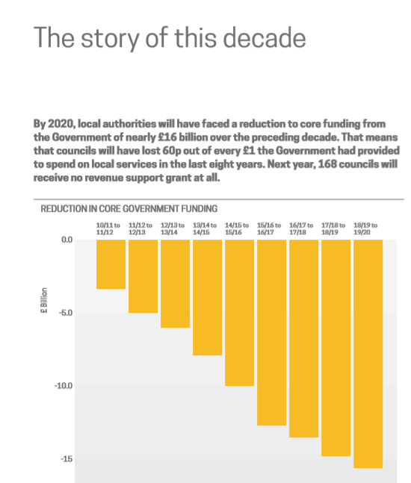
Source: LGA June 2018
Local Government Funding
Moving the Conversation on

Slide 6
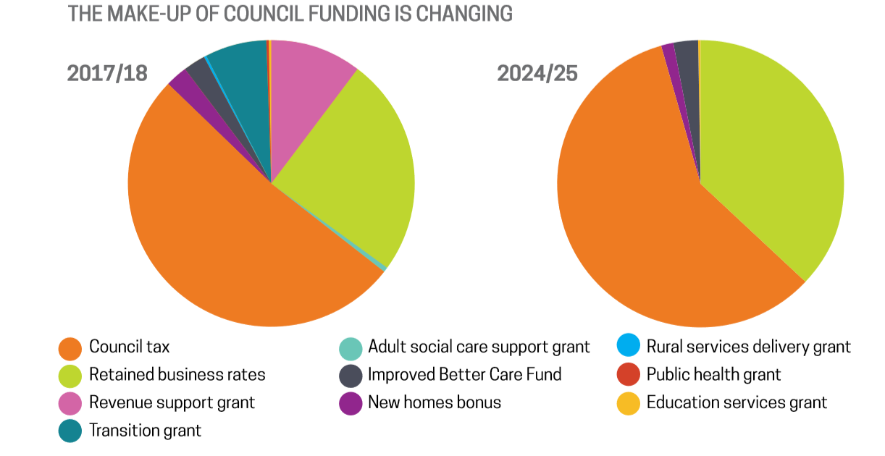
Council Tax Reduction - Background
Source: LGA June 2018
Local Government Funding
Moving the Conversation on

Slide 7
Pressures on Local Authority Budgets
Increased service demand – Adults and Children’s Social Care
Demographics – ageing population, deprivation
Reduced funding certainty
Council Tax non payment
Business Rates – greater dependence, risk, appeals, revaluations, avoidance, decline of high street
Welfare Reform
Long term sustainability
Brexit?

Slide 8
Council Tax Reduction – Background Impact on people
Significant part of system of means test support. Paid to 4.9 million households in 2017/18 – more than any other means tested payment
Part of Welfare Reform agenda
90% of Local Authorities had made some changes to their CTR schemes by 2018/19- almost all of them were cuts
Minimum payment – almost a quarter of Councils have 20% schemes in 2018/19, over a fifth have no minimum payment and another fifth have payments over 20% with North Lincs as high as 50%. Many of those with high minimum payments also have cuts in CTR in other ways

Slide 9
Council Tax Reduction – Background Impact on people
Benefit freeze - April 2016 to April 2020
Benefits are not increased (uprated) during this period regardless of the inflation rate.
Job Seekers Allowance (JSA)
Income Support (IS)
Employment Support Allowance (ESA)
Child Benefit (CB)
Applicable amounts for the calculation of Housing Benefit and Local Housing Allowance rates (HB)
Child and Working Tax Credits (C&WTC)
Universal Credit (UC)
As (CPI) sees the price of an average basket of goods increase per household, benefits will not be adjusted to compensate for this increase, thus leaving particular benefit claimants worse off.
Institute of Fiscal Studies the cumulative effects of the benefit freeze will see households lose an average of £700 to £800

Slide 10
Council Tax Reduction – Impact on people
Child Benefit – an increase of 40p for 1st child and 30p for 2nd child over 10 years. Had Child Benefit been updated in line with CPI, these would have increased by an additional £3.20 and £2.10 respectively

Slide 11
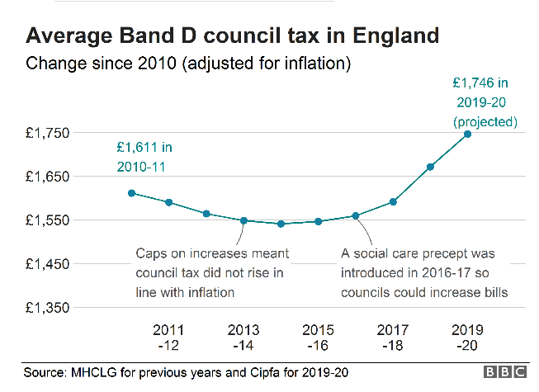
Council Tax Reduction – Background Impact on people

Slide 12
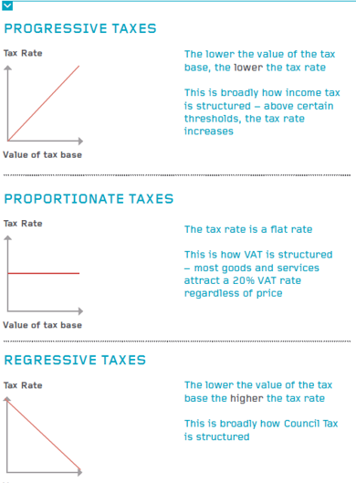
Council Tax Reduction – Background Impact on people
Income Tax
VAT
Source: Just Change: A New Approach To Local Taxation, 2015
Council Tax

Slide 13
Council Tax Reduction – Background Impact on people
Those in Band H pay three times as much Council Tax as those in Band A – Many Calls for Reform
Wealthier authorities can impose lower Council Tax increases and keep Council Tax low
Westminster Band D 19/20 £753.85
Leeds Band D 19/20 £1,644.90
Institute of Fiscal Studies May 19 said unlike other taxes ‘Council Tax is markedly regressive as it is not linked to income, with the poorest tenth of the population paying 8% of their income on Council Tax, while the next 50% pay 4-5% and the richest 40% paying 2-3%.

Slide 14
Council Tax Reduction – Issues around rising Council Tax arrears
Citizens Advice – Debt Protocol. Council Tax identified as most common issue – risen by a third in last three years
Children’s Society 2015 ‘The Wolf at the Door – how Council Tax Debt Collection is harming children’
Step Change report 2015 Council Tax Debts – How to deal with the growing arrears crisis tipping families into problem debt
MHCLG April 19 – ‘Vulnerable people who fall behind with Council Tax payments will have greater protection from aggressive debt enforcement under new plans to improve the way councils collect arrears’.

Slide 15
Impact of CTR on arrears
Arrears – Local Authority pro-active response
S13(A) 1 (c)
Vulnerability issues identified –signposting to 3rd sector
Information on bills/reminders about where to access help
Clear information on letters and website
Standard Financial Statement – Money Advice Service
Citizens Advice – Debt Protocol
Close working with enforcement agents
Wide range of payment methods
Text reminders
Deductions from benefit – lobby Govt?

Slide 16
Council Tax Reduction –
Government Policy Intention
Reduce the deficit as part of overall austerity programme
Give Local Authorities a say in their own affairs as part of the localism agenda
Support work incentives for residents
Support those with vulnerabilities
How well does your scheme fit the above?

Slide 17
Council Tax Reduction – Alignment (or not) to other benefits
Most Councils still treating CTR as a means tested benefit like Council Tax Benefit
Some alignment of other changes in Welfare Benefit system to CTR
Aligning to Housing Benefit is becoming less relevant as more cases move to Universal Credit
Universal Credit –emergence of 3rd CTR scheme – different calculation methods, monthly updates, drive to simplify process – timing a scheme change?
Simplifying without creating large cliff edges?
Difficult to understand all possible outcomes

Slide 18
Council Tax Reduction – things to remember
Schemes can be changed each year but not in year
There must be a consultation carried out before a change is made (with major preceptors and those affected by the scheme)
Time consuming
Difficult to simplify technical changes for your audience
Low engagement levels
Consultations
R (on the application of Moseley) v London Borough of Haringey [2014] ‘unfair and unlawful’ – no reference to other ways of managing financial impact
Winder / Dowen / Hampton –v- Sandwell Metropolitan Borough Council 2014 2 year residency rule – unfair no analysis of impact

Slide 19
Council Tax Reduction – things to remember
Following review of CTR schemes by Eric Ollerenshaw in 2016 – deadline for Council agreeing the scheme is now before end of March rather than the previous January 31st deadline. Helps alignment with Budget setting process
Not much time to model impacts before recommendations need to be made, consultations launched and analysis of consultation responses. All fitting in with Local Authority decision making timetables

Slide 20
Council Tax Reduction – things to remember
Equalities Impact Assessments
S13 (a) 1 (c)
Incorporation of prescribed requirements
Publish scheme and update website with changes
All done… now start working on next year!

Slide 21
Any questions?
caroline.lee@oldham.gov.uk

