Slide 1
Partnership Working – The Future of Enforcement?
IRRV Severnside & South Western Association
14th October 2016
Amanda Reynolds
Business Development Manager
Ross & Roberts
T: 07710 378307
E: areynolds@rossandroberts.co.uk
Diane Milne
Collection Services Manager
Stour Valley & Poole Partnership
T: 01202 634232
E: d.milne@poole.gov.uk

Slide 2
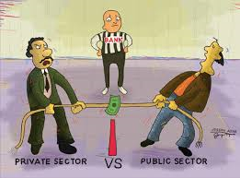
Overview
Working together?
Public v’s Private Sector??
Competition???

Slide 3
Partnership Working – The Future of Enforcement?
Partnership is a collaborative relationship between two or more parties based on trust, equality and mutual understanding for the achievement of a specified goal.
Partnerships involve risks as well as benefits, making shared accountability critical.

Slide 4
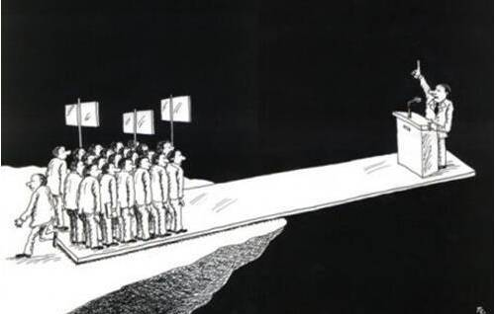
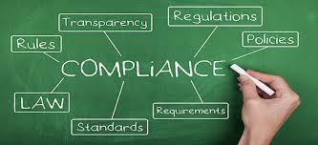
Why?
A Changing Environment
Commercial Pressures
Regulatory Compliance

Slide 5
Why
Restructure
Balance
Taxpayer at the heart
Customer centric journey
ROI
Just another stage??
Mitigate Risk
Business Case
Appropriate investment

Slide 6
How
Ross & Roberts
Resources
Systems
Process
Training
Business Case
Financials

Slide 7
How
Case Study
Review
Recommendations
Areas for Growth, Efficiency & Potential Weakness

Slide 8
The Challenges
A key decision
Spend to save
Enforcement Agents
Bonus/incentives
Team ethos
Adding Value
Objectives
Skills / experience
Justification
Holistic approach
Benefits of success

Slide 9
Summary
Partnership Greatness is Not about finding the right partner.
It is about Forging the Right Partnership

