Slide 1
IRRV May 2016
City Deal, Devolution and 100% retention of Business Rate, how it works in South Gloucestershire and the West Of England

Slide 2
Summary
City Deal – 2012
Devolution
100% Retention of Business Rate and impact on Local Government

Slide 3
South Gloucestershire & The West of England
West of England – SG, Bristol, B&NES, & NS Unitary Councils
SGC:
  Net Budget Requirement £185m, £1bn+ turnover
  Population 272,000
  One of the highest employment rates in the country, and a strong and vibrant business community.
  11,400 business, 81% Micro, 18% small & medium, 1% large
  Currently collect c£140m NDR per annum, and keep around £40m

Slide 4
Expenditure / Income Overview 2016/17 (£m)
Funding
Net
Expenditure

Slide 5
WoE City Deal – Growth Incentive
Leaders/Mayor Signed 2012, Deal finalised through 2013, Live Operation from April 2014
Government will: | Authorities will: | LEP will:
Licenced exemption from effects of resets and levies of local government finance system in five Enterprise Areas over 25 years. Enables WoE to retain 100% business rates in these areas. | Pool the business rates from the five enterprise areas and the enterprise zone, contributing £500m to a £1bn WoE Economic Development Fund. | Oversee delivery of a £1bn programme of investment to unlock and accelerate economic growth across the WoE. Led to creation of single pot and one front door for funding

Slide 6
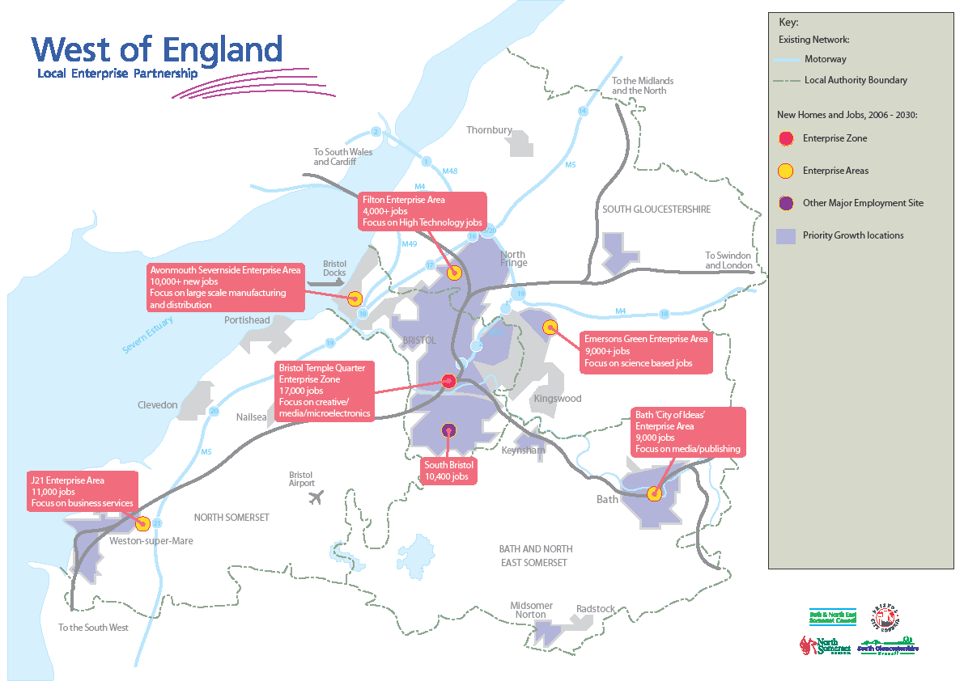
Filton
Potential for 12,000 jobs
Science based and high-technology industries
Avonmouth Severnside
Potential for 14,000 jobs
Large scale manufacturing and distribution
Emerson’s Green
Potential for 4,000 jobs
Science based and high-technology industries
Temple Quarter
Potential for 12,000 jobs
Creative, media and microelectronic sectors
Bath City of Ideas
Potential for 7,000 jobs
Media and publishing
J21
Potential for 5,000 jobs
Business services

Slide 7
How Growth Incentive Deal works
Tier 2 – £500m EDF payments
Tier 1 - £200m ‘No worse off payment’
Tier 3 - £200m demographics
Remaining funds available for UAs to assist with demographic pressures as a result of economic growth
Payments to Economic Development Fund for investment in projects which promote economic growth
Payments to UAs (value would receive under national system)
Business Rate Pool (£900m)
Avonmouth Severnside
J21
Temple Quarter
Emerson’s Green
Bath City of Ideas
Filton

Slide 8

Business rate growth forecast

Slide 9
£500m other funding sources e.g. RIF
£1bn Economic Development Fund
£500m pooled Business Rates contribution
Interventions to maximise economic returns throughout City Region through City Deal package
Skills | Innovation | Enterprise | Inward Investment | Infrastructure
Infrastructure to unlock further economic development
Critical infrastructure to unlock sites
Demand side support
Whole City Region
Flagship Projects
Sites throughout City Region
Enterprise Areas

Slide 10
City Deal
Needed to negotiate current baseline, keep growth above this baseline but also risk of falling below.
The £500m EDF income comes in over 25 years, tail ended, but WoE wanted to invest upfront
Borrowing on ‘promise’ of future income streams
  Risks including certainty of growth, future national changes
Each local council has to underwrite it’s borrowing should the EDF not be sufficient
Delivery of £500m infrastructure list focussed around priorities interventions, not where the funding was raised
Delivery of schemes now underway – Arena, Filton transport package, Bath city of ideas, Weston skills.

Slide 11
From City Deals to Devolution

Slide 12
What?
South Gloucestershire, Bristol, North Somerset, B&NES
£900m investment to the region
Additional powers from central government
Payment by Results deal
Central Government repays investment on achievement of growth
West of England (WoE) elected Metro Mayor
Signed by council leaders and Bristol Mayor
Announced by George Osborne in March budget speech
Notes:
Quick introduction as I’m sure most of you will have read or heard about the deal already
Builds on the collaborative working already undertaken by four West of England local authorities: South Gloucestershire, Bristol, North Somerset, B&NES
Would bring £900m of new investment to the region. To put this into context, this equates to £815 of investment per person living in the region, which is a significantly higher per person sum than any of the other devolution deals announced thusfar.
Part of the government’s push towards increased localism – would see additional powers devolved from central government
A Payment by Results deal. Means that we borrow money upfront and Central Government repays investment on achievement of growth targets
The government made it clear in their negotiations that any deal would be dependent on the introduction of a West of England elected mayor
Lengthy discussions and negotiations. Deal acceptable to four parties, which was signed by the council leaders and Bristol Mayor and announced by George Osborne in his March budget speech.

Slide 13
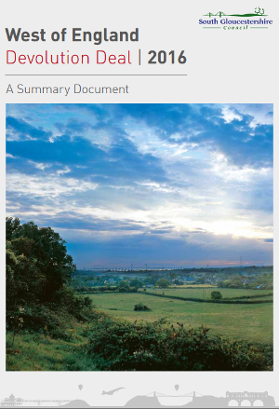
Why?
Drive growth and productivity in WoE
Triples spending on major transport over the next 10 years in line with the Joint Transport Study
Better access to employment, homes and transport
Enhanced powers to speed up new housing in line with Joint Spatial Plan
Responsibility for new Adult Education Budget and involvement in Work and Health programmes
Notes:
When the deal was first conceived the main driver was the boost it was expected to give to growth and productivity in the WoE.
WoE has highest GVA growth rate 1997-2013 and above average productivity, but becoming increasingly constrained by infrastructure deficit – road congestion in Bristol, public transport, declining housing affordability & skills shortages.
It would be closely linked to existing and highly successful joint working in the region, opening up opportunities for more cross-border projects. It will mean an even more collaborative approach to issues such as where new homes are built and how public transport improvements are delivered.
The £900m investment is expected to triple current spending on major projects such as transport, flood defence and housing over the next 10 years
A fairer region where people have better access to employment, more homes available and better transport options
Builds on the work of the Joint Spatial Plan to deliver a more collaborative, joined-up approach to public transport and new housing

Slide 14
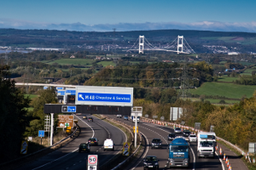
Devolution - What it would mean WoE?
Additional powers devolved from Central Government:
£900m Investment Fund to deliver infrastructure
Devolution of multi-year transport budgets
Responsibility for the new Adult Education Budget
Enhanced powers to speed up the delivery of new housing in line with the Joint Spatial Plan
Protection of City Deal
WoE Combined Authority and a new WoE elected Metro Mayor
  Mayor Chair, one vote of five but some specific powers
Protects the integrity of the four existing WoE local authorities
No intention to take existing powers from local authorities without agreement
Notes:
If supported by the individual councils, it would represent a major change, bringing decisions about transport, investment, funding, skills training, business support, housing and strategic planning into the West of England and away from central government, delivering new opportunities for businesses and residents.
Crucially, the proposed deal protects the integrity of the four existing West of England local authorities, specifically highlighting that current responsibilities would not be taken away from local councils without their agreement.
Instead it would see a West of England combined authority and a new elected mayor – who would be elected for the first time in 2017 – take control of additional powers devolved from Central Government. The metro mayor for the WoE would be in addition to, and not replace, the current mayor of Bristol and Council leaders/members.

Slide 15
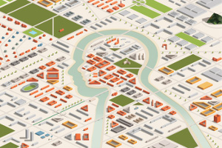
West of England Metro Mayor
Conditional on having a WoE Metro Mayor
Mayor would act as Chair of the Combined Authority
Mayor will autonomously exercise new powers, but must consult Combined Authority on his/her strategies and spending plans, which it may reject
The Mayor will have one vote as will other voting members
Notes:
The deal is conditional on having a West of England Mayor who would act as Chair of the Combined Authority. The Mayor will autonomously exercise new powers, which would include:
Business rate precept
Devolved Transport Budget
Bus Franchising and Smart Ticketing
Key Road Network and associated transport functions
‘Call-in’ strategic planning powers
Power to create Mayoral Development Corporations
The West of England Combined Authority, including the Mayor, will be scrutinised and held to account by the West of England Overview and Scrutiny and Audit committee(s). The West of England Combined Authority Mayor will also be required to consult the West of England Combined Authority on his/her strategies and spending plans, which it may reject if two thirds of the constituent council members agree to do so.
If councils sign up to the deal, the first mayoral elections are due to take place in May 2017.

Slide 16
Devolution
Significant amount of work
  First area (1 of 3) to go through this nationally
  Detailing powers and legal framework for scheme by June
  High level governance including precepting, Levy and Borrowing powers, and business rate powers of Mayor.
  If council’s agree in June, CA needs to be set up, resourced and budget set in under 12 months
    CA and Mayor separate entities
  PBR deal – independent panel – detail not known
  3 or 4 councils, potential impact?
  Potential links to 100% retention of business rates and single capital pot

Slide 17
Devolution – what happens now?
Stakeholder Engagement - May/June
June - Council Decisions
Public Consultation on Scheme(s) – July/August
Secretary of State Determination - October
Parliamentary Order - November 2016
Combined Authority Formation - 2017
Mayoral election May 2017

Slide 18
New Local Government Finance System
100% Retention of Business Rate
Fundamental shift in balance of funding for Local Government
Significant risk to councils medium term financial plans over the next 5 years
Critical to engage in development
Current System
  Keep 50% locally above baseline, less any levy. System of top ups and tariffs for national redistribution, plus a safety net.
  Also pick up 50% of valuation appeal risk

Slide 19
New System
Local Government as a sector (not locally) keeps 100% of business rates
Likely to also take 100% of risk
Will need to be some kind of redistribution nationally whilst also incentivising growth areas
Means sector will gain c£13bn of additional funds, but:
  Treasury needs it to be fiscally neutral
  So sector will gain £13bn of new duties, losses of other income
  Eg. RSG likely to go, together with some specific grants – public health
LGA steering group working with CLG to develop
4 key areas

Slide 20
Issue 1 – 100% business rate retention
For WoE needs to protect city deal
Appeal risk – carry 100% but with no additional resources (Cost neutral)?
Operation of VOA
Redistribution vs Need to Truly Incentivise Growth
Impact of National Decisions and related compensation
Issue 2 – NDR Baseline
On what all locally retained growth likely to be set
  How calculated – 2 or 3 year average – NNDR 3 returns?
  Impact of recession after set?
  Movement of appeals between authorities, different sectors?
  Reset & Revaluation

Slide 21
Issue 3 – Needs Review
Fundamental review of needs assessment
  Will impact on top-ups and tariffs and how any redistribution will operate?
Issue 4 – New Duties
How will these match to funding locally
  On transfer and moving forward with time
  Future mechanism through which additional austerity may happen

Slide 22
Summary
All 4 issues linked but could operate independently of each other, creating significant risk to MTFP
Will it be a national system or regional system or both!
  How will the system reflect and relate to Combined Authorities?
How quickly will it be brought in – big bang or phased?
Will there be any transitional funding / damping?
Is this the end of the annual finance settlement process?
What will it mean for business?
LGA / CLG Working Group
  Consultation Paper promised for the summer – policy?
  Possibly another in Autumn???

